Slide 1


Slide 2
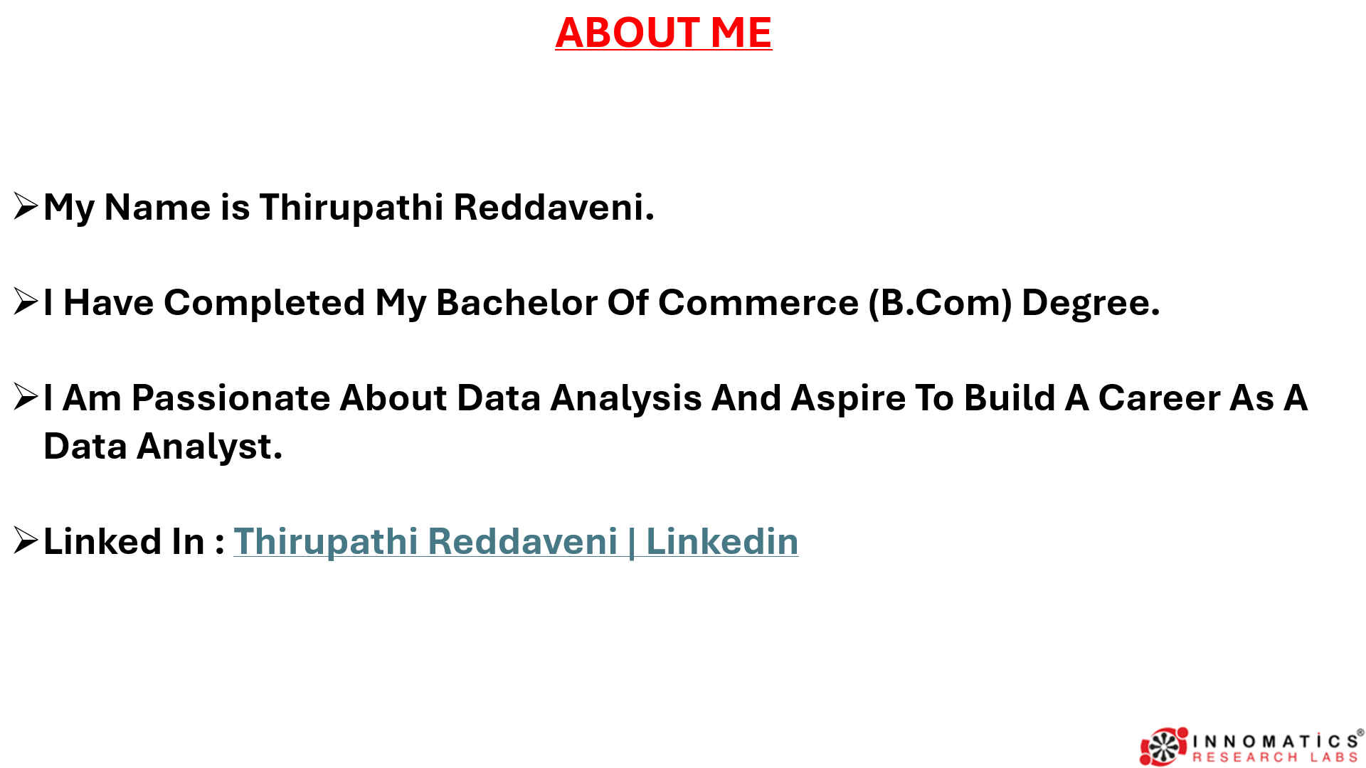

Slide 3

AGENDA
Problem Statement
Objective
Er Diagram
Key Analysis Questions With SQL Query Results
Challenges
Conclusion

Slide 4
Business Problem
What Are The Top 10 Best-selling Products?
What Is The Total Revenue?
Which Category Generates The Highest Profit?
Who Are The Most Valuable Customers?
Which Supplier Delivers The Most Products?
In Which Location Gives Us More Profit?
Eventually What We Should Do To Get More Profits?

Slide 5
Objective
Analyse Sales Trends.
Identify Top-performing Products.
Identify Top-performing Categories.
Monitor Supplier Performance.
Identify Top-performing Products.
Provide Data-driven Decision Support.

Slide 6
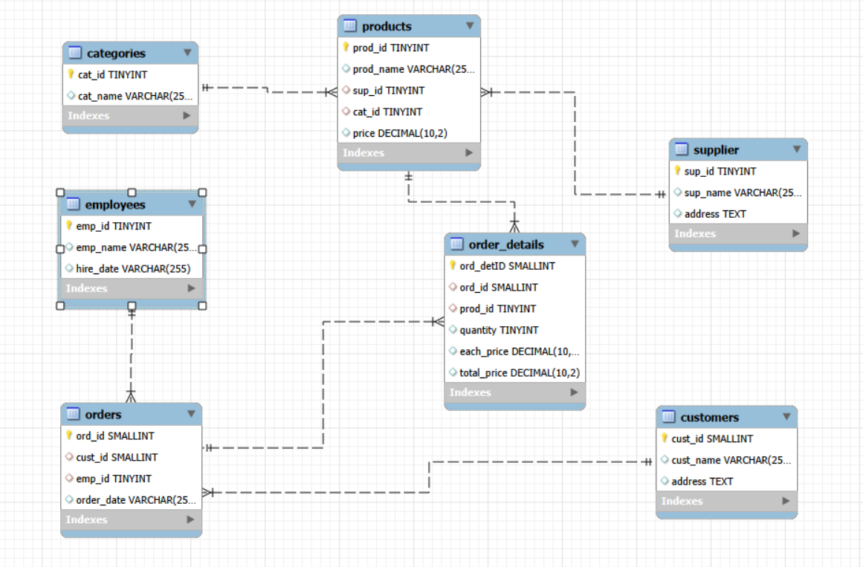
ER DAIGRAM

Slide 7
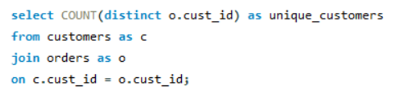

Key Analysis Questions With SQL Query Results
1. Customer Insights
How Many Unique Customers Have Placed Orders?

Slide 8
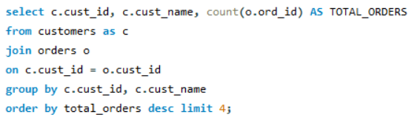
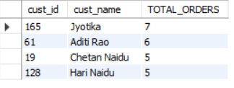
Which Customers Have Placed The Highest Number Of Orders?

Slide 9
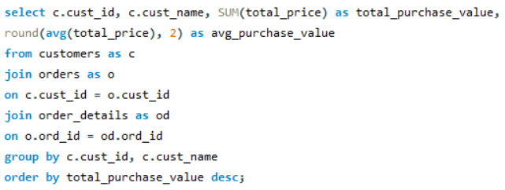
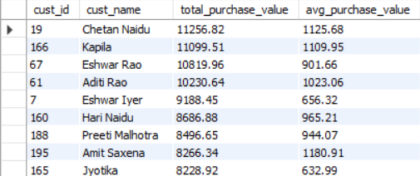
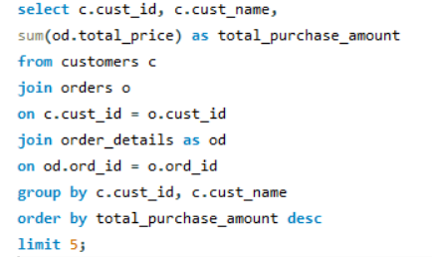
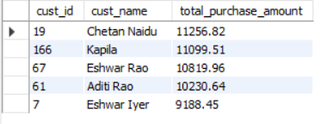
What Is The Total And Average Purchase Value Per Customer?
Who Are The Top 5 Customers By Total Purchase Amount?

Slide 10


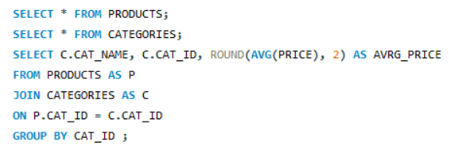
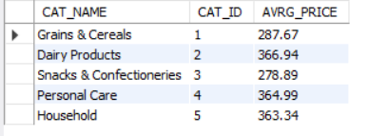
2. Product Performance
How Many Products Exist In Each Category?
What Is The Average Price Of Products By Category?

Slide 11
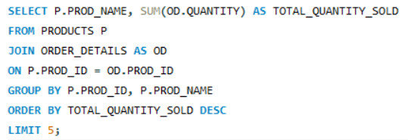
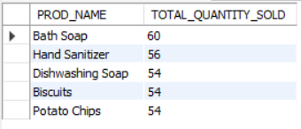
Which Products Have The Highest Total Sales Volume (By Quantity)?

Slide 12


3. Sales and Order Trends
How Many Orders Have Been Placed In Total?
What Is The Average Value Per Order?

Slide 13
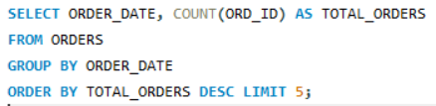
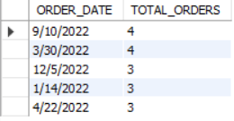
On Which Dates Were The Most Orders Placed?

Slide 14

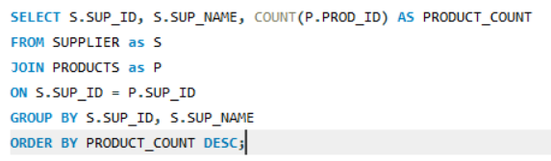
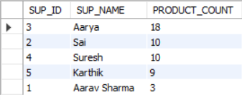
4. Supplier Contribution
How Many Suppliers Are There In The Database?
Which Supplier Provides The Most Products?

Slide 15
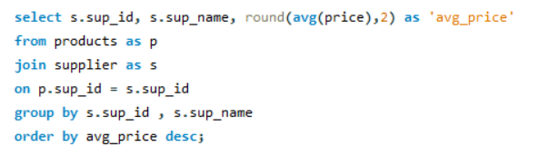
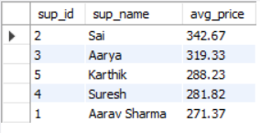
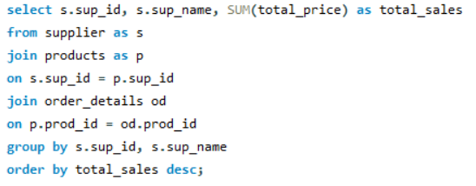
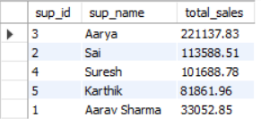
What Is The Average Price Of Products From Each Supplier?
Which Suppliers Contribute The Most To Total Product Sales (By Revenue)?

Slide 16


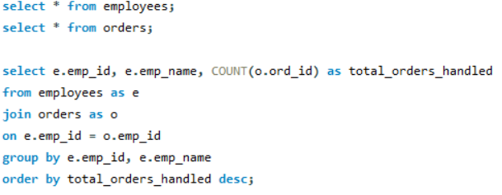
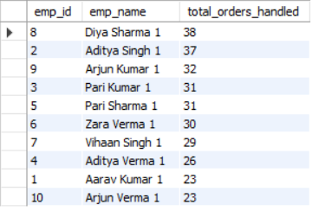
5. Employee Performance
How Many Employees Have Processed Orders?
Which Employees Have Handled The Most Orders?

Slide 17
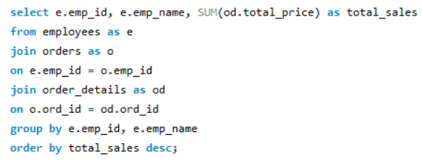
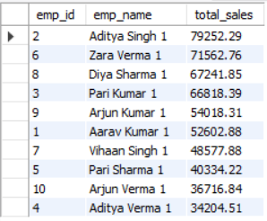
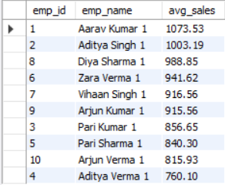
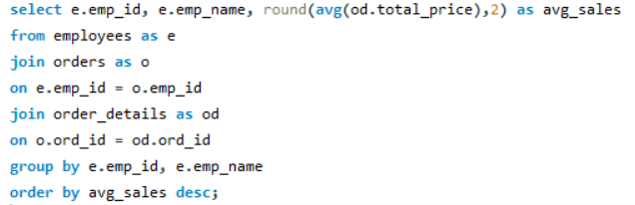
What Is The Total Sales Value Processed By Each Employee?
What Is The Average Order Value Handled Per Employee?

Slide 18
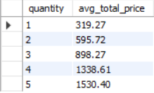
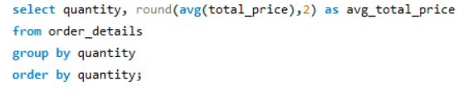
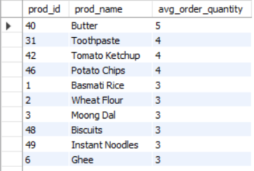
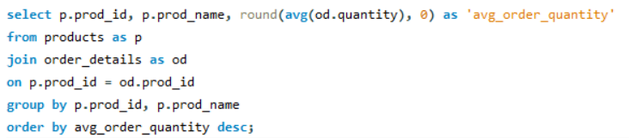
6. Order Details Deep Dive
What Is The Relationship Between Quantity Ordered And Total Price?
What Is The Average Quantity Ordered Per Product?

Slide 19

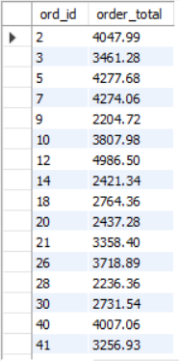
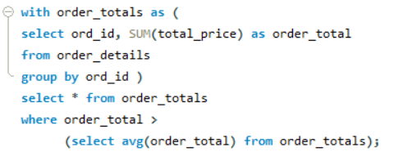
Find Orders Where Total Purchase Value Is Above The Overall Average Order Value.
Avg Purchase Value :
Orders Where Total Purchase Value Is Above Than Avg :

Slide 20
Challenges
Writing Complex JOIN Queries.
Handling Aggregate Functions With Group By & Having.
Comparing Aggregated Values Using Subqueries And CTEs.
Ensuring Accurate Calculation Of Revenue And Totals.
Understanding difference between WHERE and HAVING.

Slide 21
Recommendations
Analyze Customer Purchase Patterns To Improve Targeted Marketing.
Maintain Regular Data Updates To Ensure Accurate Reporting.
Generate Monthly Sales Reports For Better Business Planning.
Track Supplier Performance To Ensure Consistent Product Availability.
Closing Line
By Leveraging Structured Data And SQL Analytics, The Grocery Store Can Improve Operational Efficiency, Reduce Losses, And Make Informed Business Decisions.

Slide 22
Conclusion
Implemented Efficient SQL Queries To Analyze Sales, Inventory, And Customer Data.
Generated Meaningful Business Insights Such As Total Revenue, Top-selling Products, And Average Order Value.
Improved Understanding Of Joins, Aggregations, Subqueries, CTEs, And Window Functions.
Demonstrated How SQL Can Support Data-driven Decision Making In Retail Businesses.
Strengthened Practical SQL And Query Optimization Skills.
Solved Real Business Problems Using Data Analysis.

Slide 23


Slide 24


